Slide 1


Workflows in the Cloud
Heath Fuqua, Bioinformatician I, Comparative Genomics and Data Science Core
April 2024

Slide 2
Agenda
Bioinformatics Pipelines and Approaches
Amazon Web Services (AWS)
Nextflow/nf-core & Memverge
Practicum
Results
Next Steps/Questions

Slide 3
What goes into the complete analysis of a genome-scale data set? (using Bulk RNA-seq as an example)
Most complex data needs multiple steps to go from raw data to ”answers”
Example: RNAseq data to Differentially expressed genes
QC
Alignment
Quantification
Merge & Normalization
Differential Expression Analysis
Data files
(fastq)
Differentially
Expressed
Genes Table

Slide 4
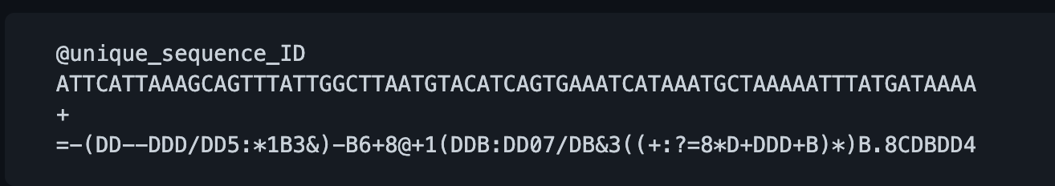
A typical RNA Seq experiment (and why we need QC)
http://cmb.molgen.mpg.de/2ndGenerationSequencing/Solas/RNA-seq.html

Slide 5
A workflow for RNA-seq Differential Expression
QC
Alignment
Quantification
Merge & Normalization
Differential Expression Analysis
Data files
(fastq)
Differentially
Expressed
Genes Table
Major question to be asked
Do I need to search for new genes/transcripts?
“Alignment => Assignment” or
“Alignment Free”

Slide 6
Alignment Approach to Quantification
Genome Sequences
PostQC Sequences
Alignment to target
Alignment file
Expression Vector
Quantification
Genome/Transcriptome Annotation

Slide 7
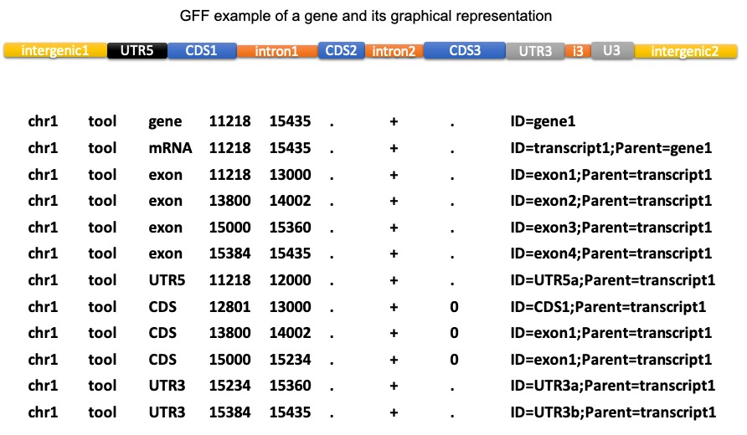
Gene information must be provided (e.g., GFF)

Slide 8
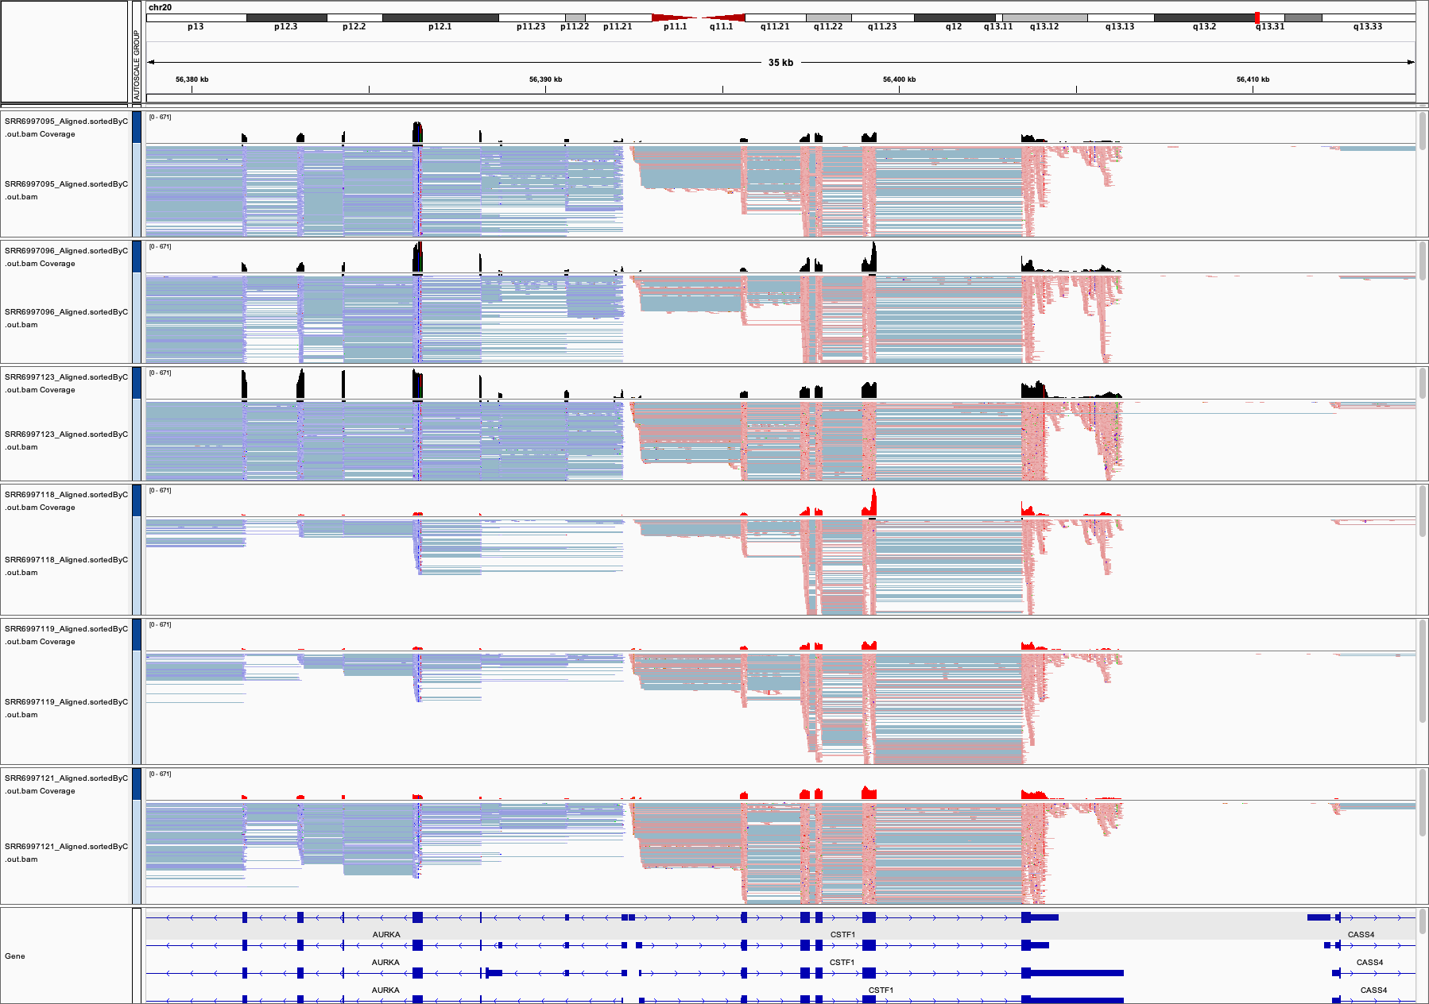
RNA-seq analysis: alignment/quantification

Slide 9
Alternative approaches to Quantification
Genome Sequences
PostQC Sequences
Alignment to target
Alignment file
Expression Vector
Quantification
Genome/Transcriptome Annotation
Alignment-free assignment

Slide 10
A workflow for RNA-seq Differential Expression
QC
Alignment
Assignment
Merge & Normalization
Differential Expression Analysis
Data files
(fastq)
Differentially
Expressed
Genes Table

Slide 11
After expression is assessed in each sample, they are merged into a “count matrix”
gene_name | AL_TO_rep01 | AL_TO_rep02 | AL_TO_rep03 | DR_TO_rep01 | DR_TO_rep02 | DR_TO_rep03
aap-1 | 753 | 747 | 743 | 940 | 947 | 982
aat-1 | 27 | 24 | 14 | 15 | 28 | 14
aat-2 | 30 | 33 | 24 | 60 | 65 | 68
aat-3 | 134 | 137 | 127 | 78 | 67 | 93
aat-4 | 23 | 45 | 35 | 22 | 30 | 27
aat-5 | 38 | 33 | 29 | 123 | 84 | 105
aat-6 | 40 | 39 | 28 | 41 | 46 | 55
aat-7 | 1 | 1 | 0 | 2 | 4 | 6
aat-8 | 1 | 1 | 2 | 14 | 3 | 10
aat-9 | 362 | 399 | 374 | 370 | 328 | 370

Slide 12
Computational normalization is critical for transcriptome analysis
Three standard approaches to computational normalization
Internal normalization (Quantile, VST, FPKM, TPM, etc)
Assume all samples are roughly the “same,” and force equal distributions
Insensitive to global changes
Internal standard normalization
Identify a relatively small number of “unchanging” targets and scale all values so that these values are equal in all samples
External standard normalization
Add a known control (“Spike-in”) and then scale values such that the values for the controls are the same

Slide 13
To interpret our count matrix, we need an Experimental Design File
At minimum, the Design File must contain
Identifiers for each sample (ideally matched to a data filename)
Assignment of all experimental parameters under consideration to each sample
Ideally- ANY feature/variable that might vary between samples
sample | treatment | rep
AL_TO_rep01 | AL | rep01
AL_TO_rep02 | AL | rep02
AL_TO_rep03 | AL | rep03
DR_TO_rep01 | DR | rep01
DR_TO_rep02 | DR | rep02
DR_TO_rep03 | DR | rep03

Slide 14
A workflow for RNA-seq Differential Expression
QC
Alignment
Assignment
Merge & Normalization
Differential Expression Analysis
Data files
(fastq)
Differentially
Expressed
Genes Table

Slide 15
The end result for all genes (in visual form)
Increased by treatment
Decreased by treatment
Increased average expression
across all samples

Slide 16
In the end, a table of DE Gene Scores (e.g., with DESeq2)
id | baseMean | log2FoldChange | lfcSE | stat | pvalue | padj
aagr-1 | 269.129364535602 | -1.7442675672456 | 0.117789943380256 | -14.8082893767481 | 1.29494023689411E-49 | 4.77497892947039E-48
aagr-3 | 2008.77205021688 | -0.150425067741619 | 0.0418534931952695 | -3.59408632965959 | 0.0003255318965062 | 0.00115773135585242
aak-2 | 243.639422569596 | 0.278051661358966 | 0.118395785760709 | 2.34849289248301 | 0.0188495589454439 | 0.0458599158655762
aakb-2 | 415.838439463941 | 0.561118701249279 | 0.100734483891487 | 5.57027424544835 | 2.54338675055636E-08 | 1.56247902940004E-07
aakg-1 | 365.852541550914 | 0.50046549824763 | 0.0971820567244253 | 5.149772654707 | 2.6080239032197E-07 | 1.40999077665866E-06
aakg-3 | 14.7626365586319 | 1.32753612196484 | 0.538581116196545 | 2.46487684406741 | 0.0137060352076937 | 0.034635107180592
aakg-4 | 72.0407425048923 | 1.73861272918138 | 0.251164464315594 | 6.92220825871598 | 4.44656882831695E-12 | 3.78784449623833E-11
aakg-5 | 736.490245516047 | -0.171877365357521 | 0.063262738817093 | -2.71688150989571 | 0.00659001957329092 | 0.018076559672254
aap-1 | 846.749244306947 | 0.216032066870877 | 0.0694242604499855 | 3.11176619629258 | 0.00185971722699245 | 0.00572240163660642
aars-2 | 2065.39673387659 | 0.132015428540962 | 0.0446828104046726 | 2.9545014591821 | 0.0031317467246952 | 0.00916240085776832
aat-2 | 45.7630124225589 | 1.01639572482027 | 0.300017225171763 | 3.38779123178136 | 0.000704578716201275 | 0.00236338649524766

Slide 17
What goes into the complete analysis of a genome-scale data set? (using Bulk RNA-seq as an example)
QC
Alignment
Assignment
Merge & Normalization
Differential Expression Analysis
Program choice
Program choice
Program choice
Program choice
Program choice
Differentially
Expressed
Genes Table
Data files
(fastq)
Program parameters
Program parameters
Program parameters
Program parameters
Program parameters
Adapter/
primer sequences
Genomic sequences
Genomic annotations

Slide 18
“Rigor and Reproducibility”
Every choice outlined in the last slide can impact results of analysis
Recording, monitoring, and sharing these factors is now recognized as critical in genomics analysis
A required aspect of all NIH grant proposals
Also required by many journals
Resource: Karl Broman (Wisconsin)
http://kbroman.org/steps2rr/
http://kbroman.org/dataorg/pages/resources.html

Slide 19
Workflow (pipeline) systems solve many issues
Easy reproducibility of results
Reduction in human error
Organization of output
Reduced work in program installation, maintenance, and troubleshooting

Slide 20
Basics of Workflow definition languages
At the base level is a single command, wrapped to accept input and generate output
This structure (including dependencies) is captured in the workflow
Input1
Output1
Input2
MyProgram
Output2
Input3
Output3

Slide 21
Basics of workflow definition languages
Workflows are built from multiple steps, encapsulated in “modules”
Input1
Output1
Input2
MyWorkFlow
Output2
Input3
Output3
Step1
Step2
Prog1
Prog2
Step2/Output2 => Output2
Input1 => Step1/Input1
Unused/temporary output
Step1/Output1 => Step2/Input3
Step1/Output2 => Output3

Slide 22





Several popular workflow description languages and engines are available
Workflow Definition Language
Snakemake
Common Workflow Language (CWL)
Nextflow/nf-core

Slide 23
Basics of Workflow Systems
A workflow system consists of
A language capable of describing the process that captures dependencies and computational complexities
A program (“engine”) capable of
Reading and executing the workflow description
Requesting/allocating the necessary computational resources to carry out the work
The power of these systems is that workflows
Can be run on any system for which an engine has been programmed and set up
Can be rerun for new data sets and/or analysis by changing a simple text-formatted parameter file

Slide 24
Community supported workflows: NextFlow/NF-core
https://nf-co.re/
Nf-core Pipelines are
(Mostly) focused on specific data type
Supported by teams of volunteers
A systematic way to get systematic execution, logging, and organized output
Generally “best-practice” accepted steps

Slide 25
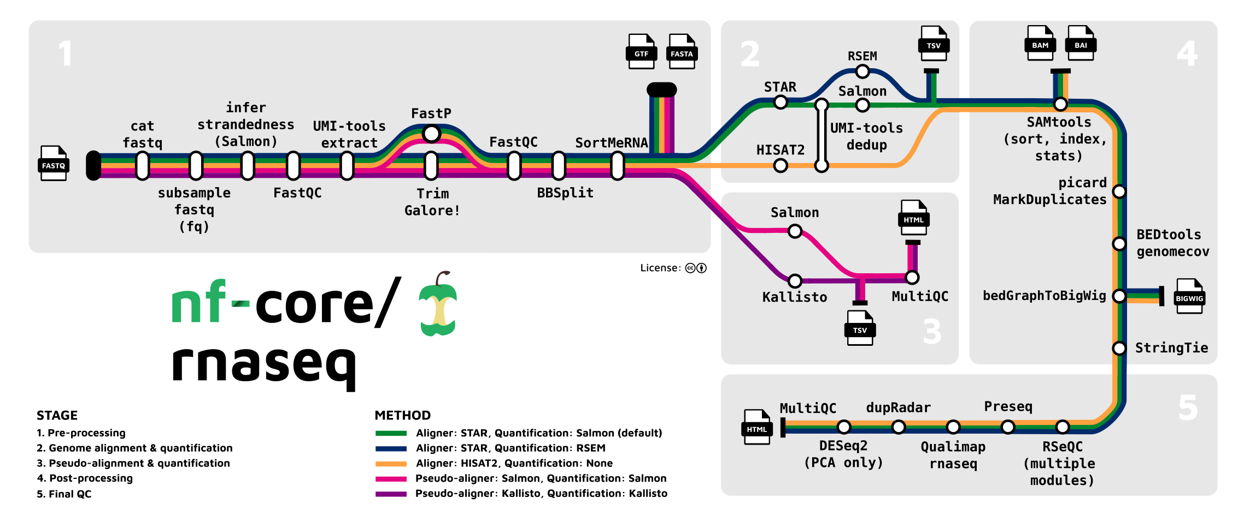

Slide 26
After the NF-core: working with your output
NF-core pipelines generally focus on the standard common analysis step
Many summary output files are available
Output tables can become input to other tools
RNA-seq analysis with Sequin
https://sequin.ncats.io/app/

Slide 27
Summary and concluding thoughts
Workflows allow for systematic and reproducible execution of complex, multi-step analysis of genome-scale data
Community-supported workflows let you
Carry out best-in-practice analysis plans
Reduce effort and potential error
Keep track of analysis steps and output for subsequent downstream analysis and reporting/publication
The learning curve is still not trivial
We can help

Slide 28
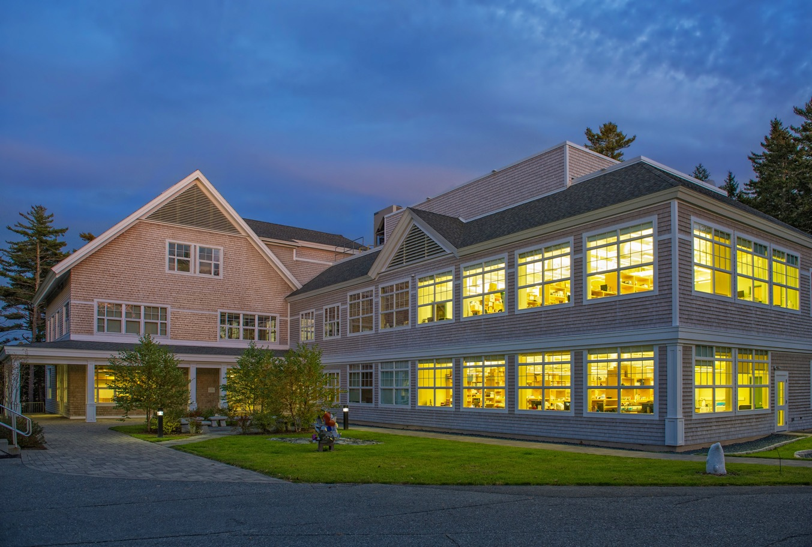
Thank you!

